Slide 1
Full Stack Development
Configuring Routes
Name: B.Yashaswi Kumar
Roll No.: 22H51A0508
Class: CSE - D

Slide 2
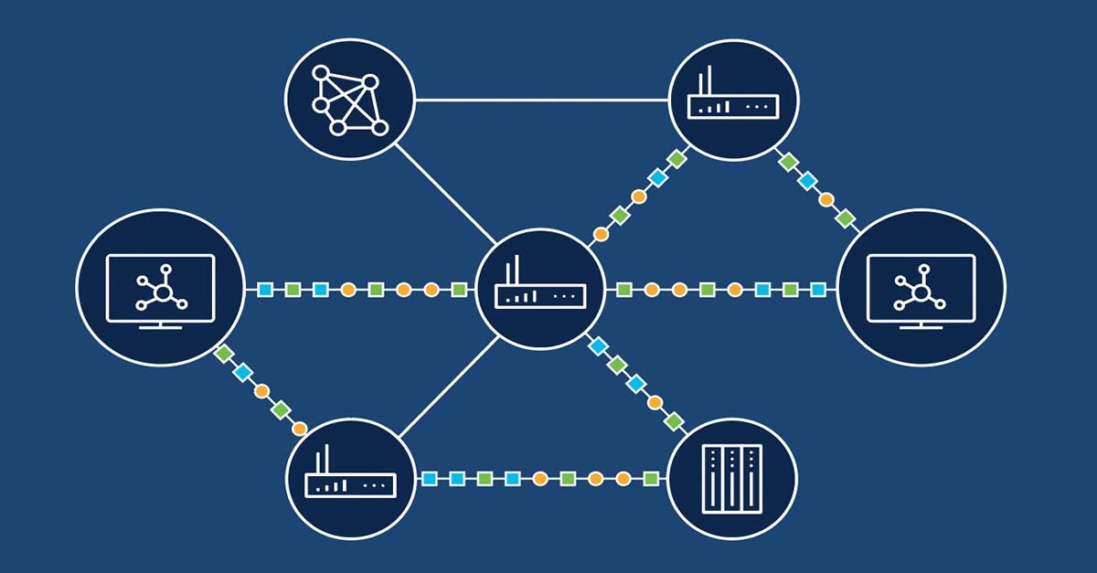
Introduction to Routing
Routing is the process of selecting paths in a network to send data packets.
It plays a critical role in determining how data travels across different networks.
Understanding routing is essential for effective network design and management.
Notes:
Image source: https://www.cisco.com/c/en/us/products/routers/what-is-routing.html

Slide 3
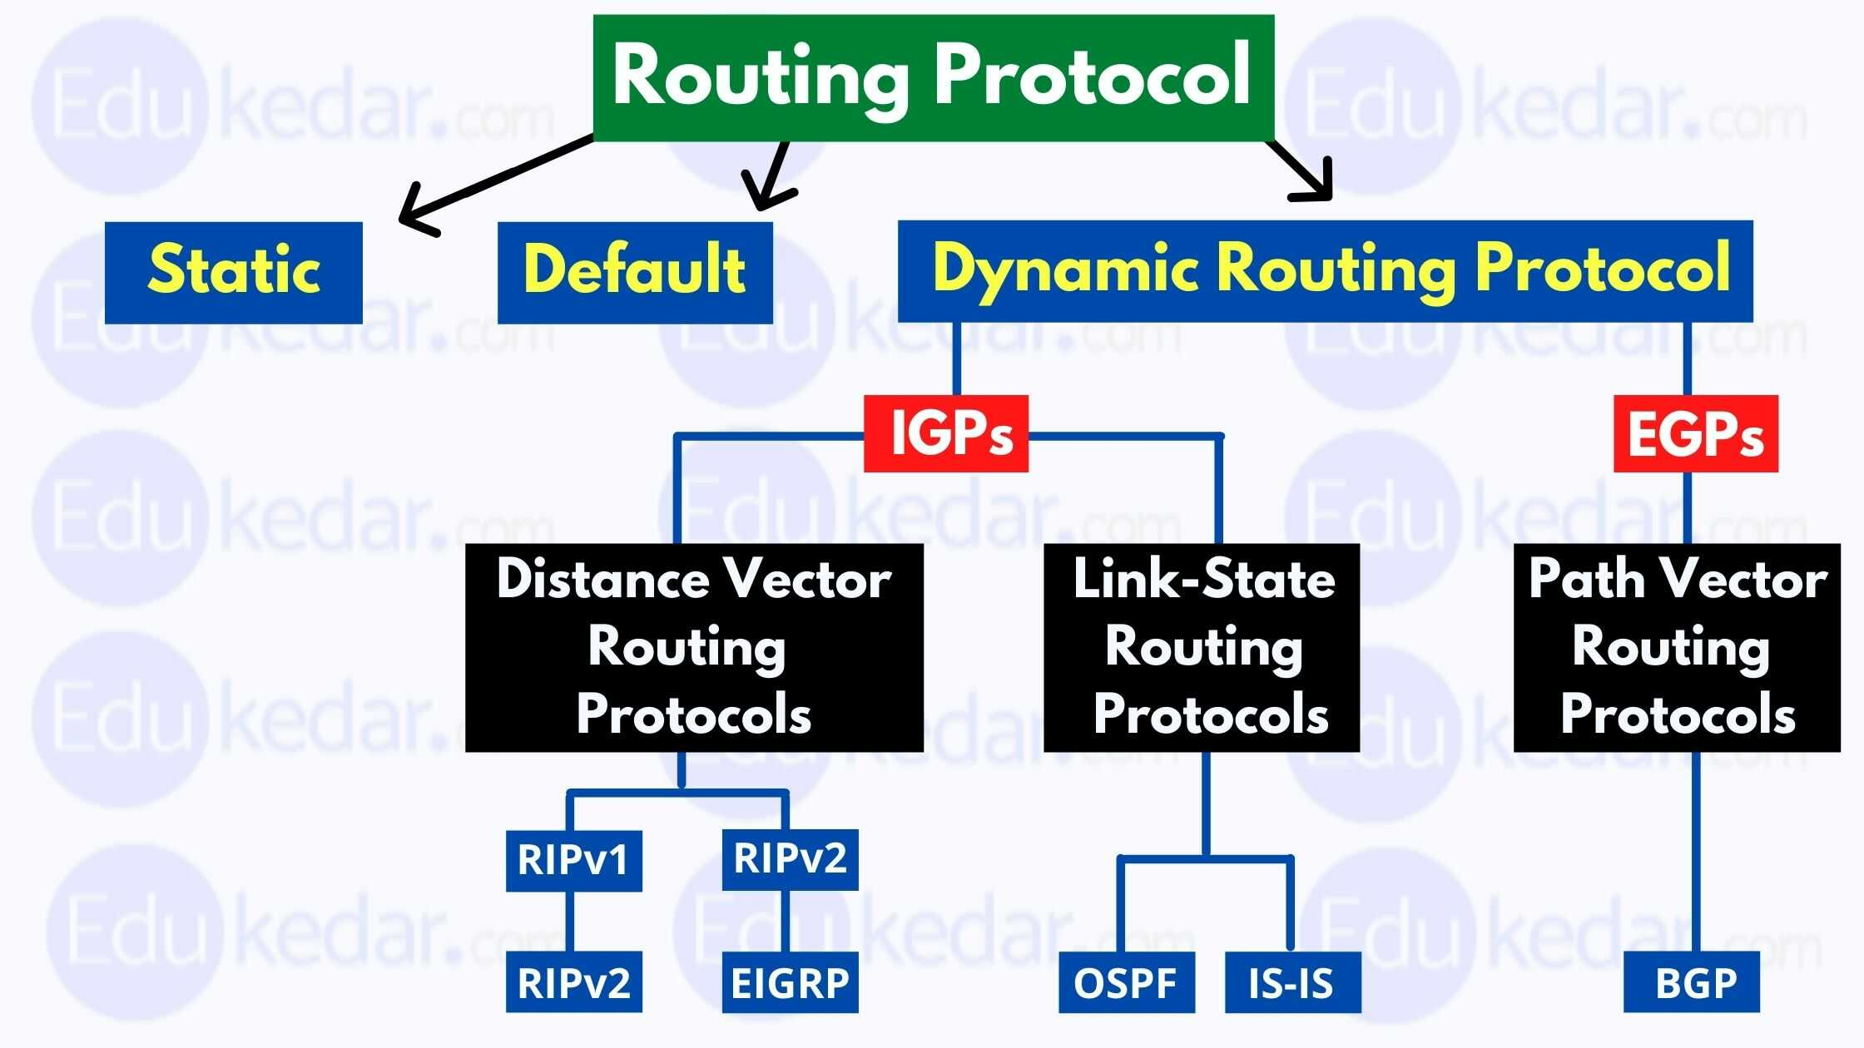
Types of Routes
There are two primary types of routes: static and dynamic.
Static routes are manually configured and do not change unless altered by a network administrator.
Dynamic routes are automatically adjusted by routing protocols based on network conditions.
Notes:
Image source: https://edukedar.com/routing-protocols/

Slide 4
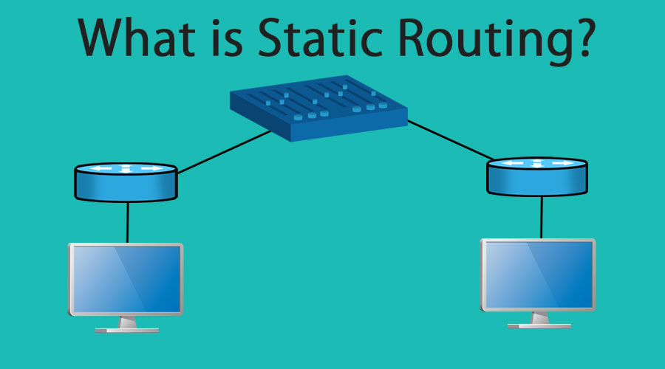
Static Routing
Static routing involves setting a fixed path for data packets to follow.
It is suitable for smaller networks where changes are infrequent.
The main advantage is simplicity, but it lacks flexibility in adapting to network changes.
Notes:
Image source: https://www.educba.com/what-is-static-routing/

Slide 5
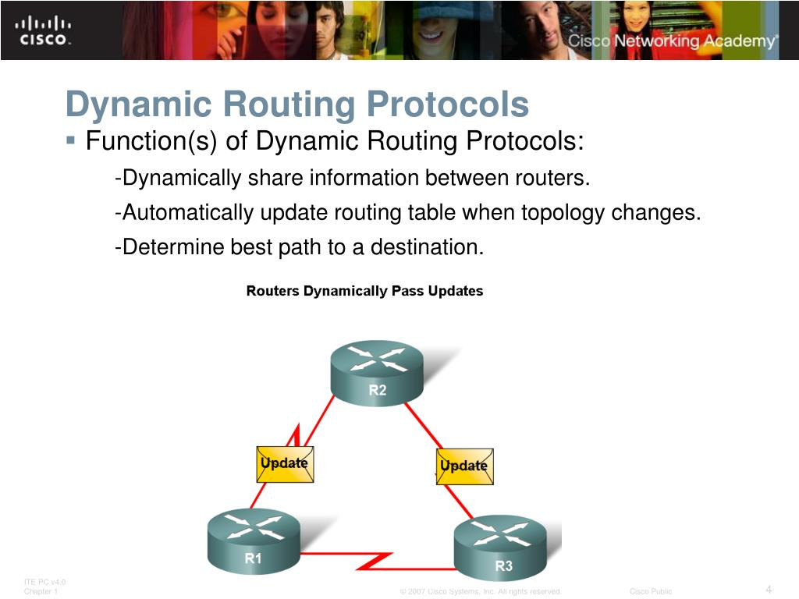
Dynamic Routing
Dynamic routing utilizes algorithms and protocols to determine optimal paths.
It can automatically adjust to network changes, such as failures or new connections.
Common dynamic routing protocols include RIP, OSPF, and BGP.
Notes:
Image source: https://www.slideserve.com/cricket/introduction-to-dynamic-routing-protocol

Slide 6
Routing Protocols Overview
Routing protocols are rules that dictate how routers communicate with each other.
They help maintain consistent routing tables across different devices.
Different protocols are suited for different types of networks and applications.
Notes:
Image source: https://edukedar.com/routing-protocols/

Slide 7
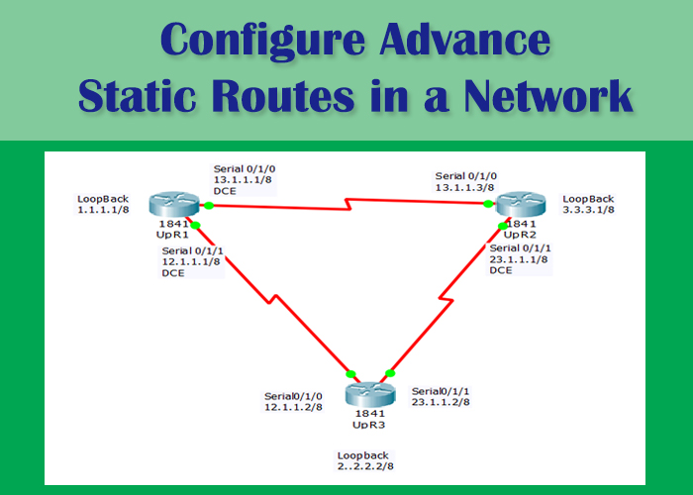
Configuring Static Routes
To configure a static route, the network administrator specifies the destination and next hop.
Command-line interfaces (CLI) are commonly used for configuration in routers.
It’s essential to verify the route after configuration to ensure proper functionality.
Notes:
Image source: https://upaae.com/advance-static-routing-configuration/

Slide 8
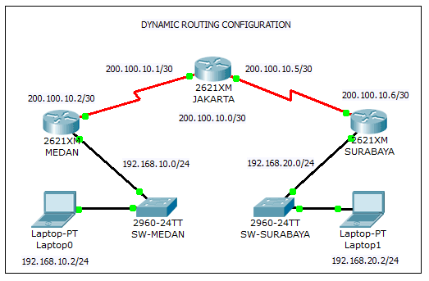
Configuring Dynamic Routes
Dynamic routes are configured by enabling specific routing protocols on routers.
Administrators must ensure that all routers in the network use compatible protocols.
Monitoring tools can help assess the efficiency and effectiveness of the dynamic routing setup.
Notes:
Image source: https://networkencyclopedia.com/dynamic-routing/

Slide 9
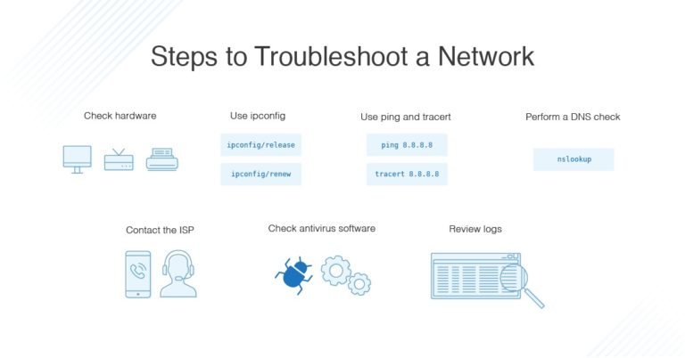
Troubleshooting Routing Issues
Common routing issues include incorrect configurations or network topology changes.
Diagnostic tools such as ping and traceroute can help identify routing problems.
Regularly reviewing routing tables and logs can prevent many common issues.
Notes:
Image source: https://www.dnsstuff.com/network-troubleshooting-steps

Slide 10
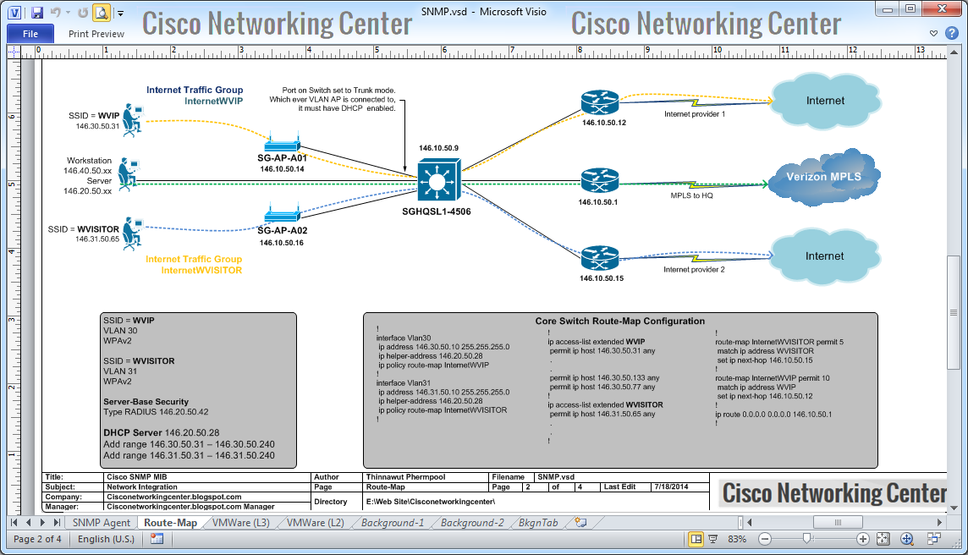
Best Practices for Route Configuration
Always document route changes to maintain an accurate network map.
Regularly back up routing configurations to avoid data loss.
Keep routing protocols updated to ensure optimal performance and security.
Notes:
Image source: https://cisconetworkingcenter.blogspot.com/2014/07/configuration-examples-route-map-and.html

Slide 11


